Slide 1

Methodist College of Engineering & Technology
Group Number:5
Guide Name: Ms. Unnati K
Project Title: Voice Based Email System
Project Team: 961CS-A05
S. No. | Roll no. | Student Name | Role in Team
1 | 160717733008 | T SAI CHARAN REDDY | Team Leader
2 | 160717733004 | N GAGAN KUMAR | Team Member
3 | 160717733032 | A SREEKAR | Team Member
Under the guidance of Project Coordinator
Ms. Unnati K Mr. M. Krishnamurthy
Assistant Professor Assistant Professor
Department of CSE Department of CSE

Slide 2
ABSTRACT
As the technology is enhancing, people are coming closer to digital life and digital communication. There are many ways to communicate with others through internet in this new advanced era.
E-mail is one of the technologies that enables user to contact with others by sending mails and also helps in business world communication. There are people who cannot use these technologies because either they are illiterate or do not have ability to view the screen.
So, to make this technology closer to visually challenged people. We proposed a Voice Based E-mail System. This architecture will help visually challenged people to access e-mail and provides them the facility of communication, make them much stronger and independent.

Slide 3
SYSTEM DESIGN
System Architecture
UML Diagrams
  Class Diagram
  Use Case Diagram
  Sequence Diagram
  Data Flow Diagram
  Activity Diagram
  State Chart Diagram
  Deployment Diagram

Slide 4
System Architecture
FRIEND
REGISTER BLIND USER
SERVER
SEND/READ EMAIL
VISUALLY IMPAIRED USER
SPEECH COMMAND
NOTIFY USER
EMAIL SERVER
RECOGINZE SPEECH
APPLICATION
VOICE MESSAGE
LISTEN USER
TEXT TO SPEECH
SEND EMAIL NOTIFICATION
SPEECH TO TEXT

Slide 5
UML DIAGRAM

Slide 6
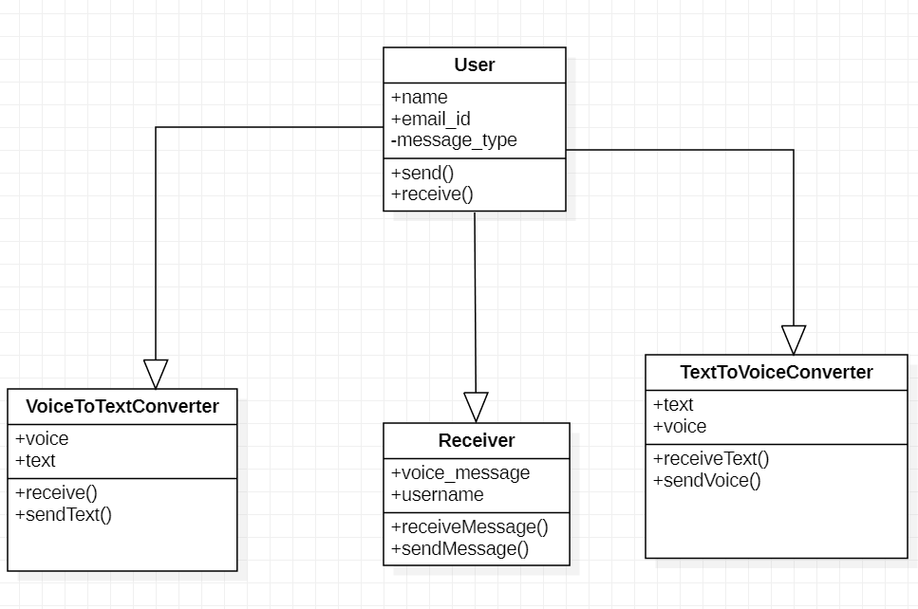
CLASS DIAGRAM

Slide 7
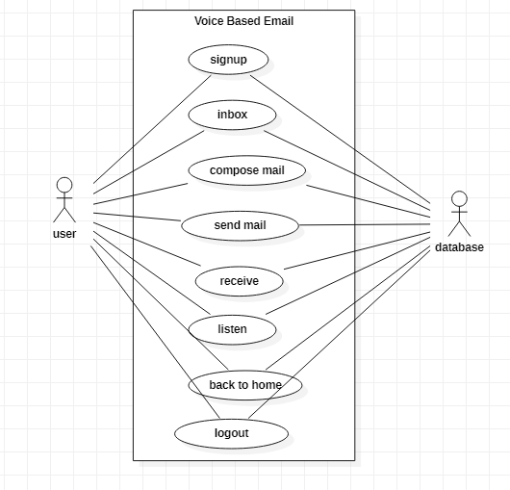
  Use Case Diagram

Slide 8
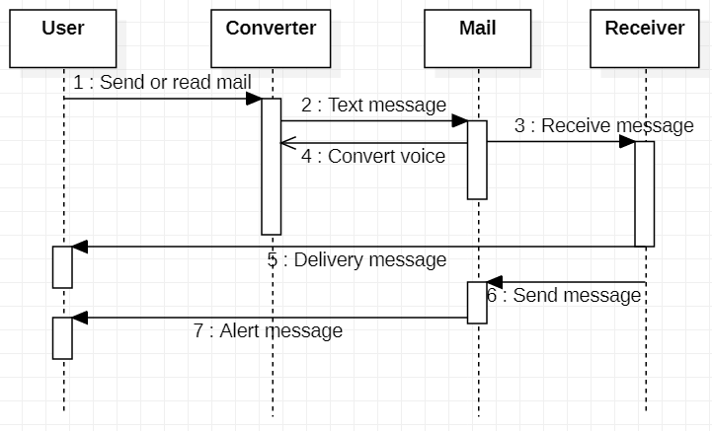
  Sequence Diagram

Slide 9
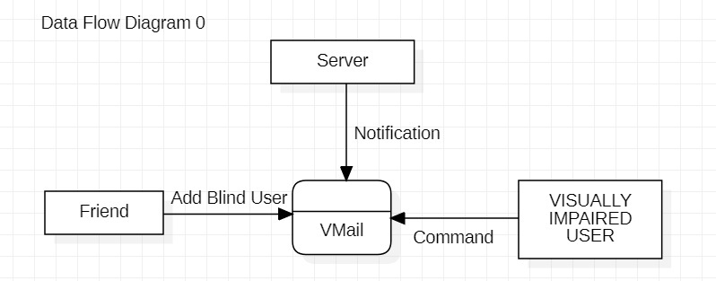
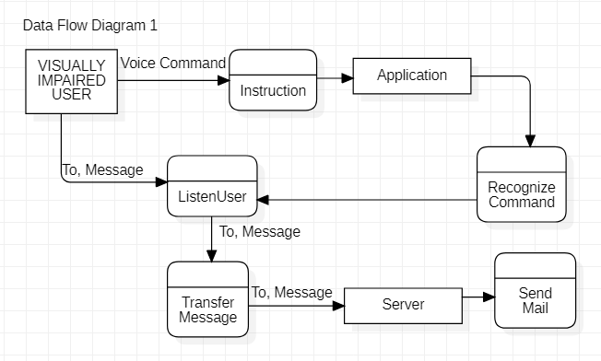
  Data Flow Diagram

Slide 10
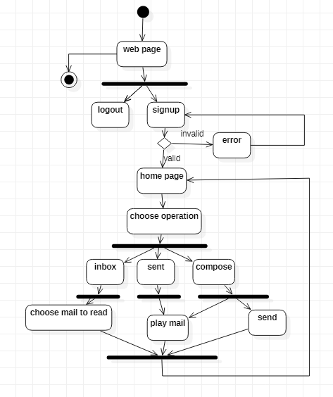
  Activity Diagram

Slide 11
  State Chart Diagram
User
Voice to text converter
Alter message
Send text
Send message
Send voice
Voice based email
Delivering report
Voice message
Receiver
Voice message
Text message
Text to voice converter

Slide 12
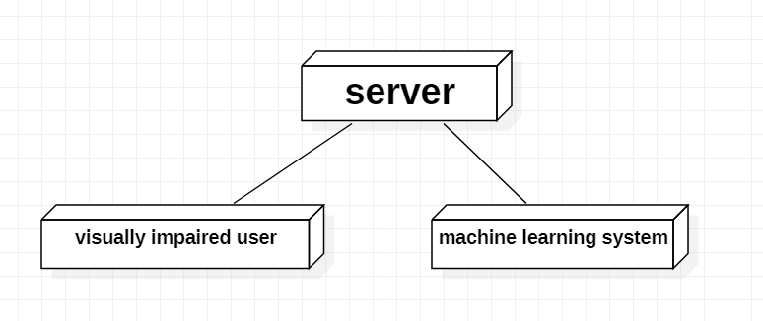
  Deployment Diagram

Slide 13
System Architecture
FRIEND
REGISTER BLIND USER
SERVER
SEND/READ EMAIL
VISUALLY IMPAIRED USER
SPEECH COMMAND
NOTIFY USER
EMAIL SERVER
RECOGINZE SPEECH
APPLICATION
VOICE MESSAGE
LISTEN USER
TEXT TO SPEECH
SEND EMAIL NOTIFICATION
SPEECH TO TEXT

Slide 14
CLASS DIAGRAM

Slide 15
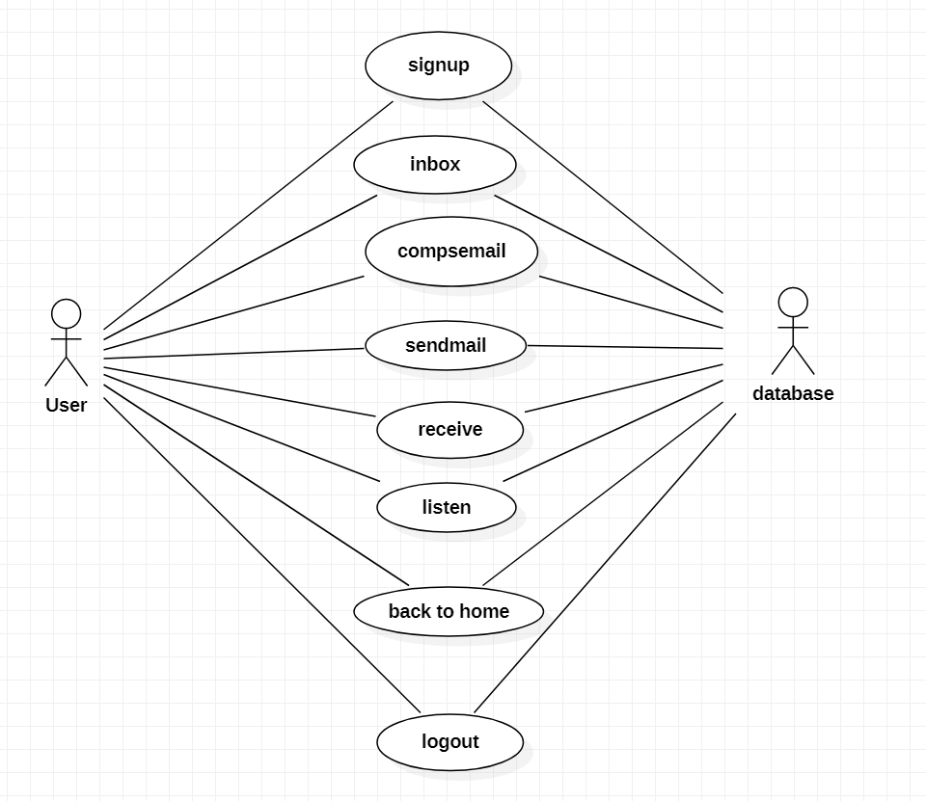
  Use Case Diagram

Slide 16
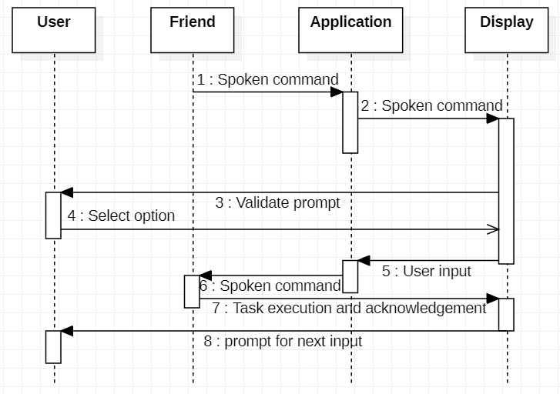
  Sequence Diagram

Slide 17
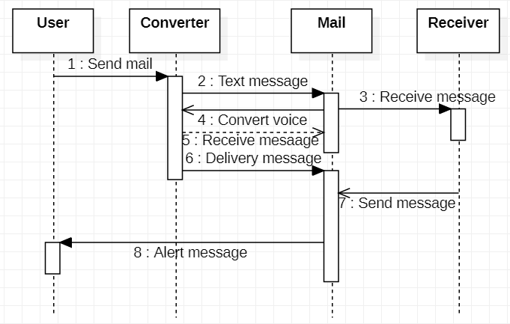
  Sequence Diagram

Slide 18
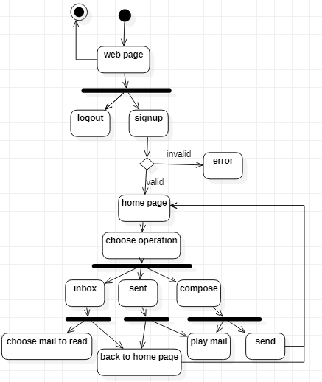
  Activity Diagram

Slide 19
  State Chart Diagram
User
Voice to text converter
Alter message
Send text
Send message
Send voice
Voice based email
Delivering report
Voice message
Receiver
Voice message
Text message
Text to voice converter

Slide 20
  Data Flow Diagram

Slide 21
  Deployment Diagram

Slide 22
Any Queries..?

Slide 23
Any Queries..?

Slide 24
Thank you…

